Slide 1
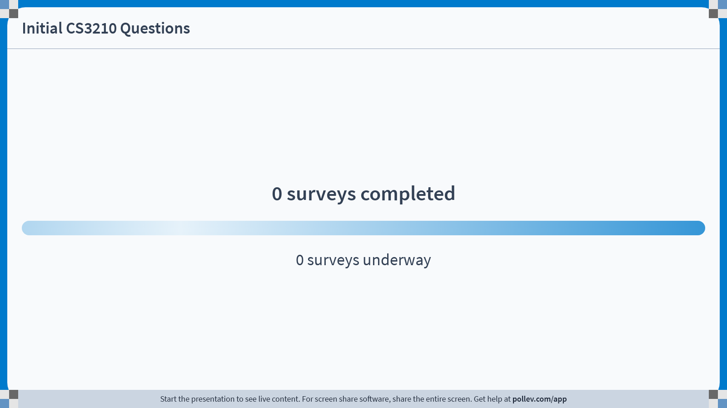
Notes:
Poll Title: Do not modify the notes in this section to avoid tampering with the Poll Everywhere activity. More info at polleverywhere.com/support Initial CS3210 Questions https://www.polleverywhere.com/surveys/Pzt0ojdVnmLlUd1Dx7Tez?display_state=chart&activity_state=opened&state=opened&flow=Engagement&onscreen=persist

Slide 2
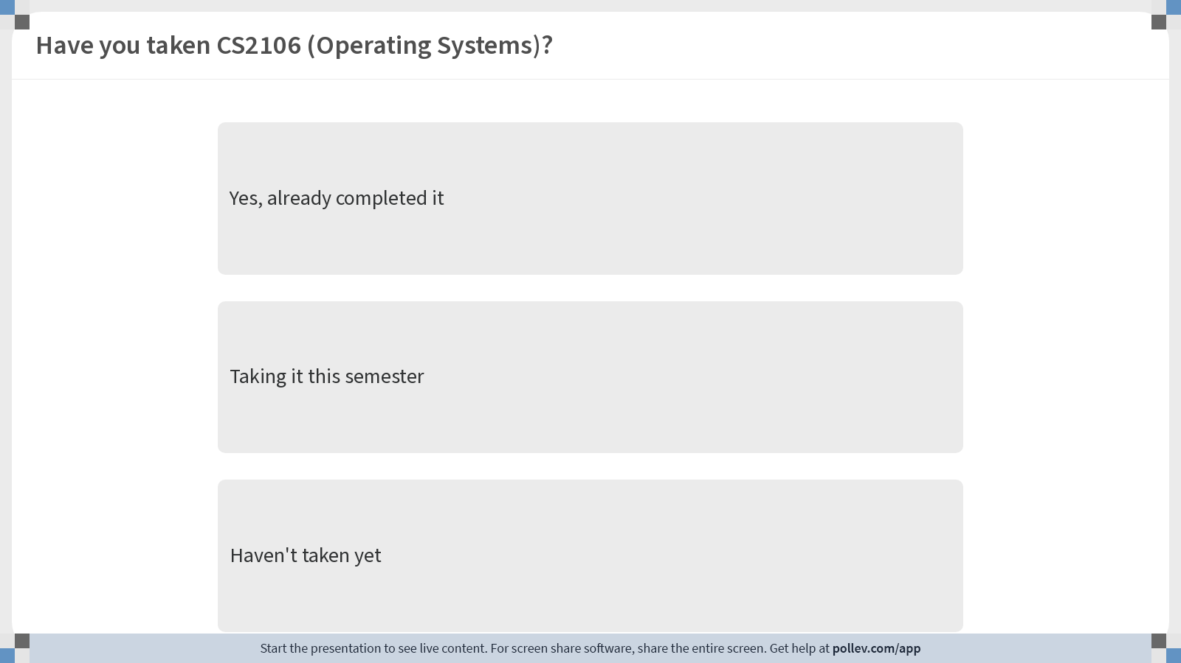
Notes:
Poll Title: Do not modify the notes in this section to avoid tampering with the Poll Everywhere activity. More info at polleverywhere.com/support Have you taken CS2106 (Operating Systems)? https://www.polleverywhere.com/multiple_choice_polls/r6UBymthL82BHl5VyuNi1?display_state=chart&activity_state=opened&state=opened&flow=Engagement&onscreen=persist&hide=instructions

Slide 3
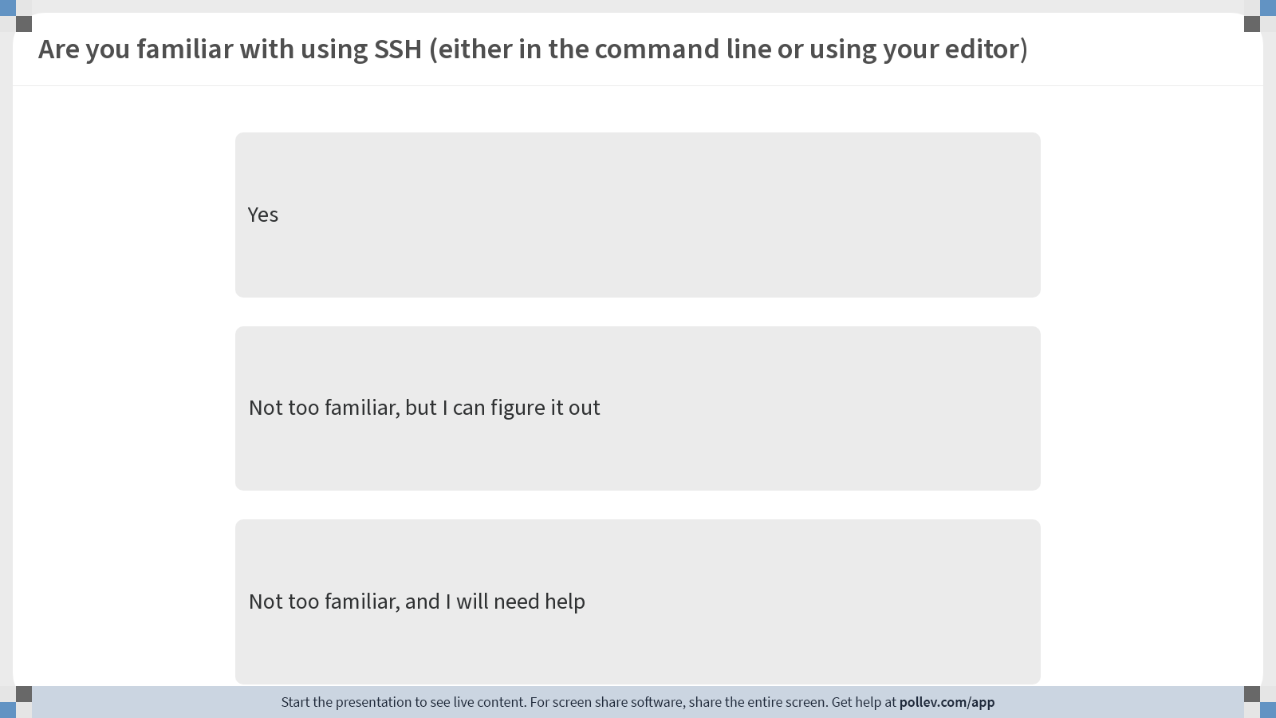
Notes:
Poll Title: Do not modify the notes in this section to avoid tampering with the Poll Everywhere activity. More info at polleverywhere.com/support Are you familiar with using SSH (either in the command line or using your editor) https://www.polleverywhere.com/multiple_choice_polls/EeGJNM3LYxbNgD95yn5HU?display_state=chart&activity_state=opened&state=opened&flow=Engagement&onscreen=persist&hide=instructions

Slide 4
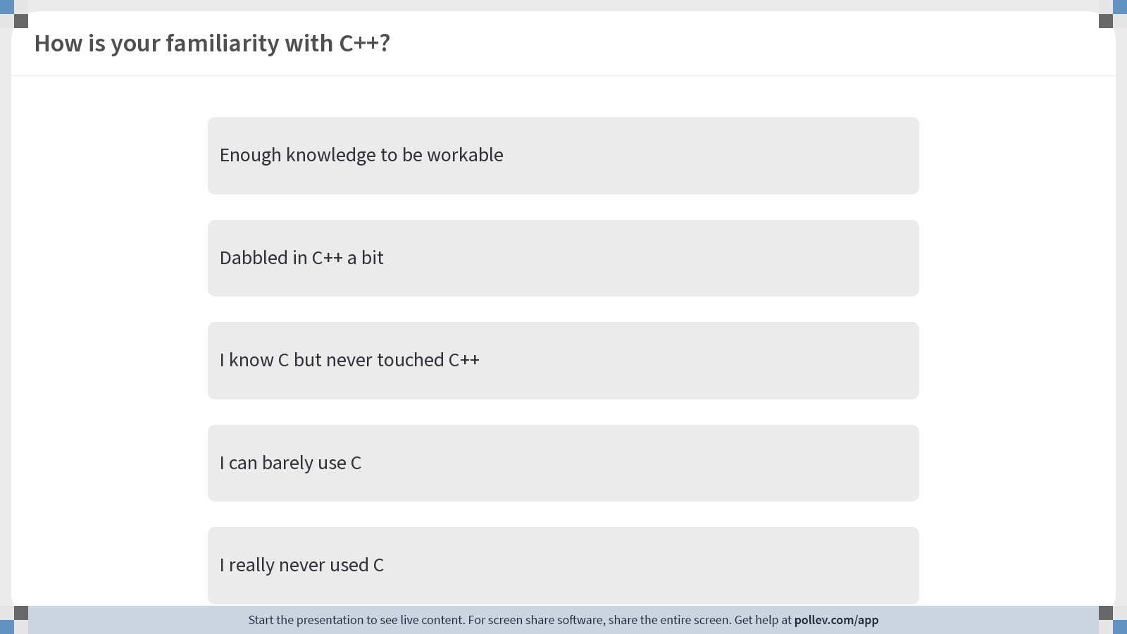
Notes:
Poll Title: Do not modify the notes in this section to avoid tampering with the Poll Everywhere activity. More info at polleverywhere.com/support How is your familiarity with C++? https://www.polleverywhere.com/multiple_choice_polls/bzwDtZOQinCeloU2B8tid?display_state=chart&activity_state=opened&state=opened&flow=Engagement&onscreen=persist&hide=instructions

Slide 5
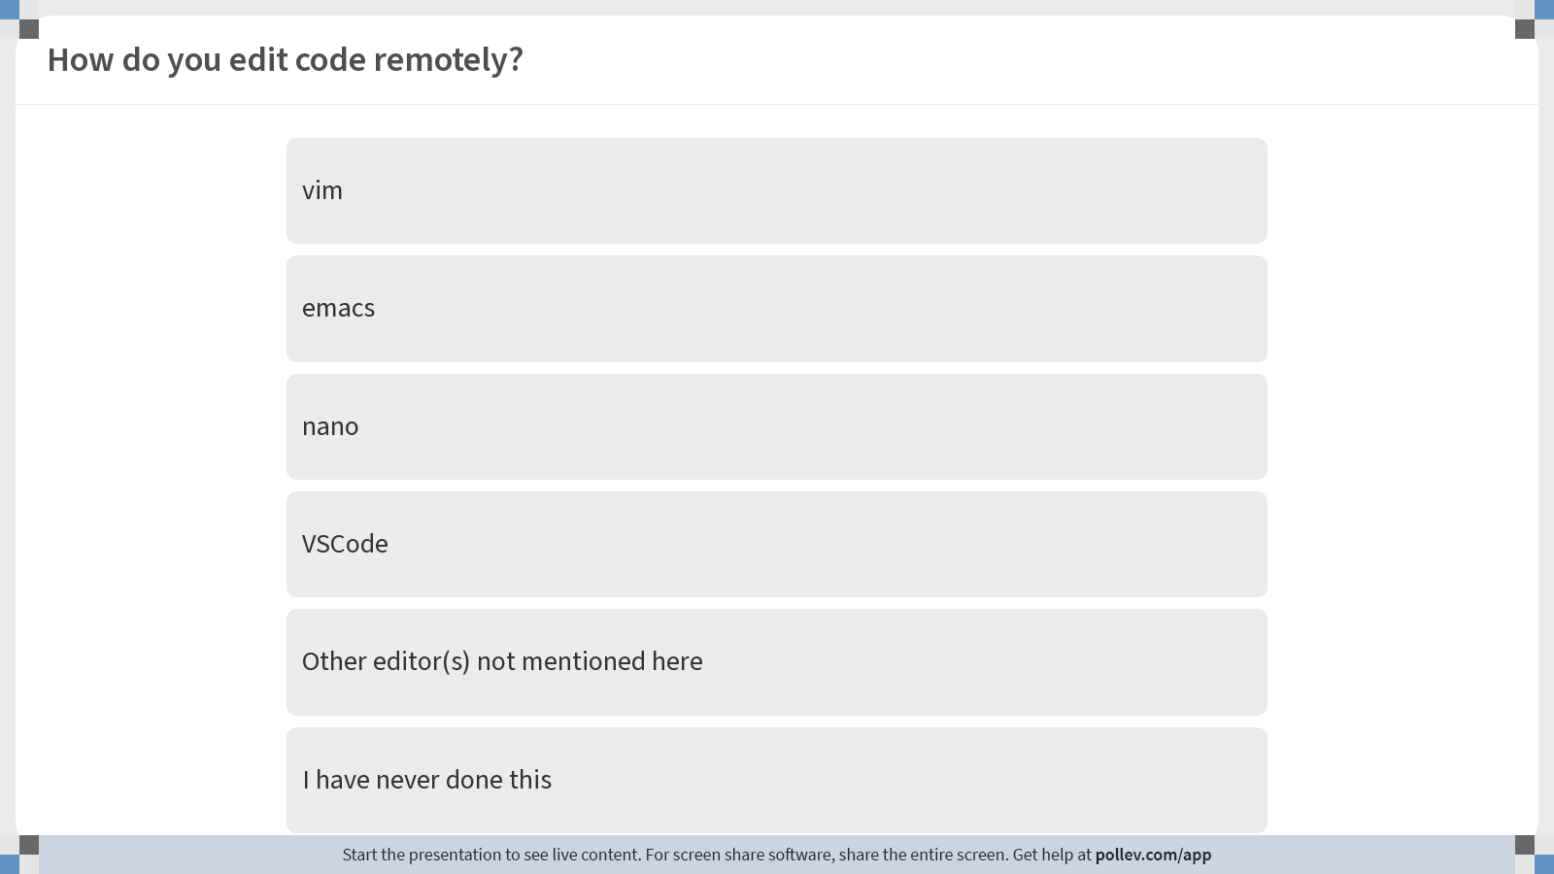
Notes:
Poll Title: Do not modify the notes in this section to avoid tampering with the Poll Everywhere activity. More info at polleverywhere.com/support How do you edit code remotely? https://www.polleverywhere.com/multiple_choice_polls/e3fJGVoZm1zlmbwHNEzg4?display_state=chart&activity_state=opened&state=opened&flow=Engagement&onscreen=persist&hide=instructions

Slide 6
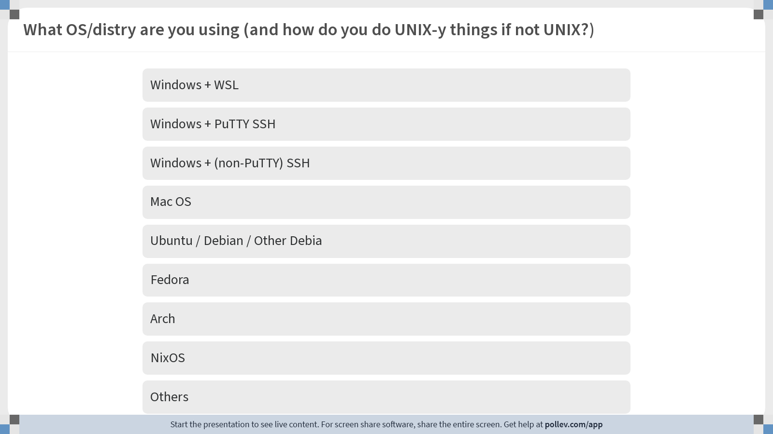
Notes:
Poll Title: Do not modify the notes in this section to avoid tampering with the Poll Everywhere activity. More info at polleverywhere.com/support What OS/distry are you using (and how do you do UNIX-y things if not UNIX?) https://www.polleverywhere.com/multiple_choice_polls/qmxpKlBfgvnGFOHmBaJSB?display_state=chart&activity_state=opened&state=opened&flow=Engagement&onscreen=persist&hide=instructions

Slide 7
CS3210 Lab 1
Processes, Threads, and Synchronization Basics
Theodore’s slides; heavily inspired by Sriram’s, Richard’s, Cristina’s and Zhi Heng’s slides.

Slide 8
About myself
Theodore Leebrant
(Theodore/Theo is good!)
Computer Science + Mathematics
was a PL nerd, mostly with Rust
Plays too much Final Fantasy XIV
Out-of-tutorial communication:
Email: theo@comp.nus.edu.sg for consults, questions
Telegram: details later
Will reply messages within 24 hours – except 2 days before deadlines

Slide 9

Quick admin stuff
Telegram group:
Things that are OK
Banter
Interesting finds
Lab cluster issues / requests
Things that are not OK
Code debugging help (unless you spot something funny in our code)
Slides will be uploaded after every session
Anonymous feedback: bit.ly/feedback-theodore

Slide 10
Why are we here?
Make things go fast
(latency)
Make things finish quickly
(throughput)
Make things go fast efficiently
(energy efficiency)

Slide 11
CS3210 from 30,000 feet in the sky
Part 1: OpenMP
Making single-node CPU programs faster
Complex tasks that are relatively less parallelizable (10s of tasks)
Part 2: CUDA
Making single-node GPU-able programs faster
Simpler tasks that are relatively more parallelizable (millions of tasks even)
Part 3: MPI
Making multi-node programs faster
Large, mixed workloads (slow communication between nodes is worth it due to size / parallelizabilty of work)
The complexity: how to harness this power effectively?

Slide 12
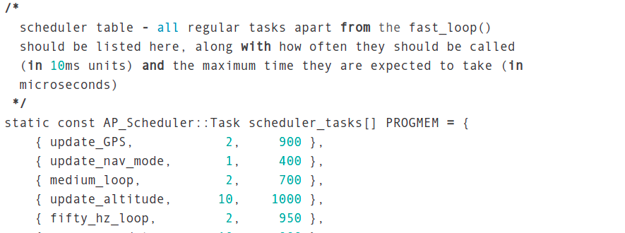
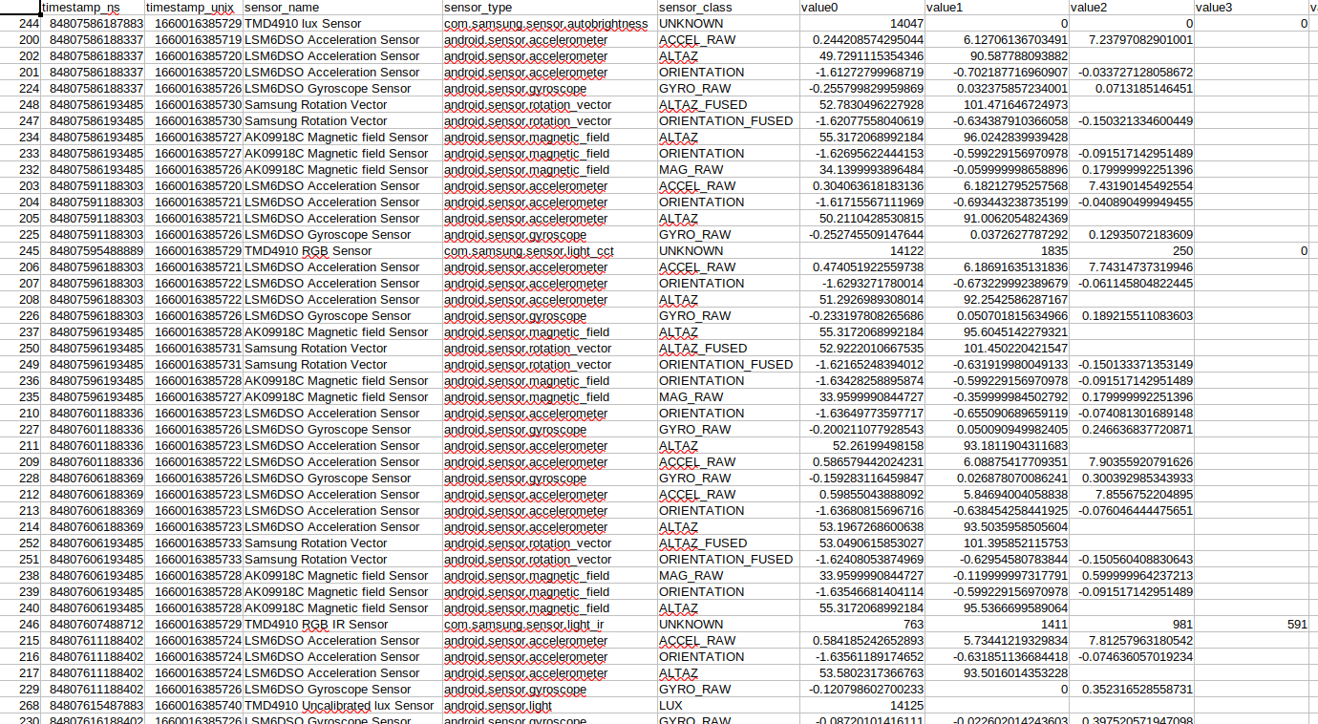
Our goals for the semester
(not just “finish the tutorials & labs” and “pass your exams”)
1. Learn how to decompose problems into tasks in your sleep
sometimes a curse: cannot unsee this :)
Task parallelism
Data parallelism

Slide 13
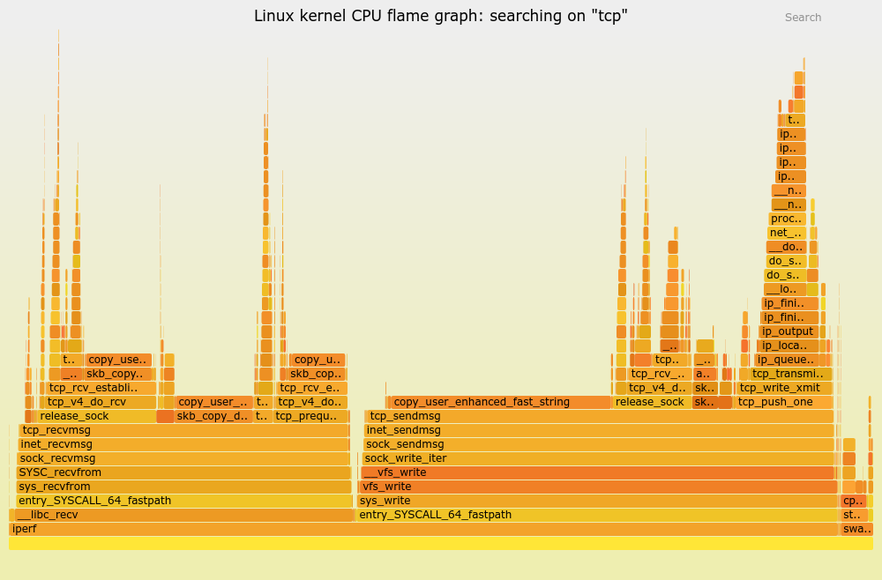
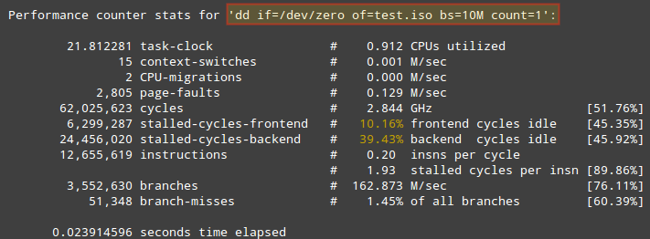
Our goals for the semester
(not just “finish the tutorials & labs” and “pass your exams”)
2. Become systems detectives: think holistically about performance
Is it the algorithm? Disk? Cache? Network? Not enough work? Too much work? Synchronization overhead? Theory alone is useless here.

Slide 14
Our goals for the semester
(not just “finish the tutorials & labs” and “pass your exams”)
3. Have fun!
Very satisfying to make a program faster. You will hopefully understand soon :)

Slide 15
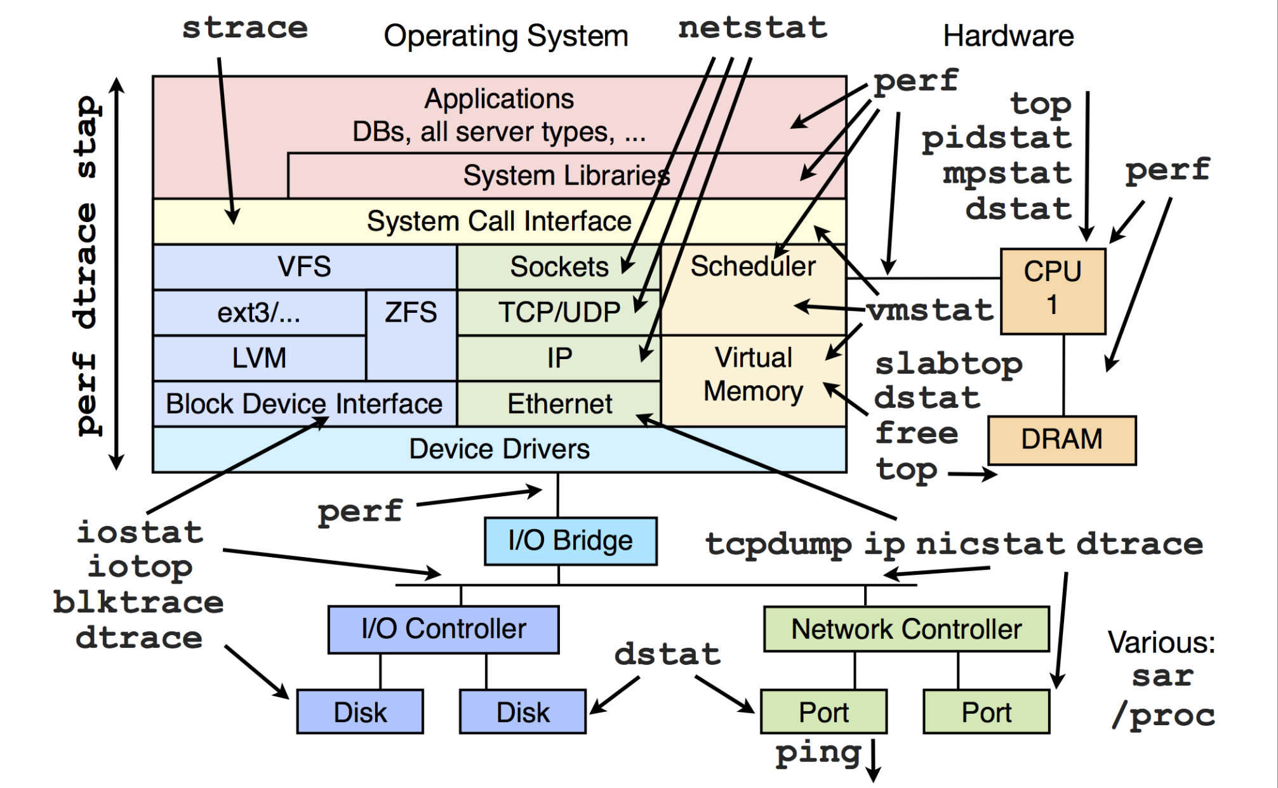
No such thing as stupid questions: ever
“Systems” are made up of many, many parts
Infinite learning process
Please feel free to bring anything up
Personal promise: all questions will be treated equally

Slide 16
General Lab Workflow
For you:
Labs/Tutorials are for you to learn. No stress. Only a small percentage of grade. Please experiment!
Feel free to talk, communicate, work together! Submit separately, state who you worked with.
First tutorial slot challenges…
Me:
I will probably not give direct answers, but I will guide :)
Will be hovering around, try not to be conscious of it, trying to help
Might interrupt with solutions and interesting behaviours / questions
Will start at :05 and finish in ~1h, but will stay back for questions

Slide 17
CS3210 Lab 01
Processes / Threads / Synchronization

Slide 18
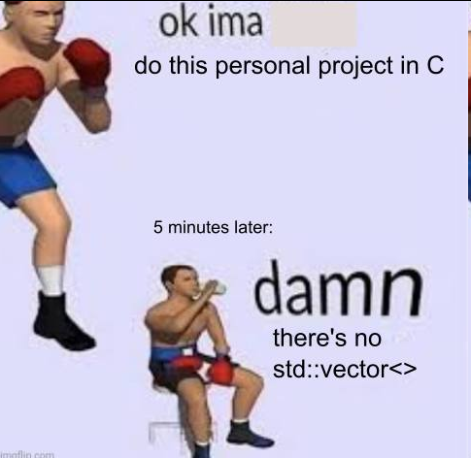
Things to note for labs
‘C-style’ C++ programming language
C++ only! Even if you want to write C…
[Lab 1] Use only the pthread library.
(i.e. don’t use std::mutex, std::thread, …)
Do the lab exercises in order!
Submit the necessary exercises
Lab 1 deadline: next week, 2 Sept, 1400hrs

Slide 19
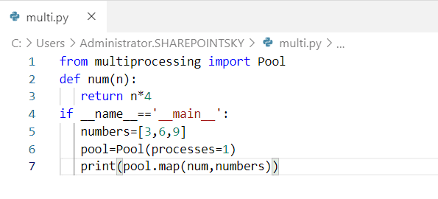
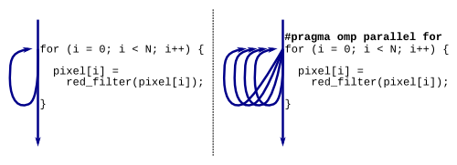
Why synchronization for lab 1?
(because anyone can solve embarrassingly parallel problems.)
Python
C/C++

Slide 20
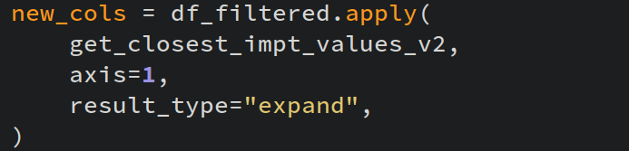
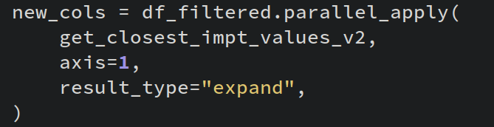
Why synchronization for lab 1?
(because anyone can solve embarrassingly parallel problems.)

Slide 21
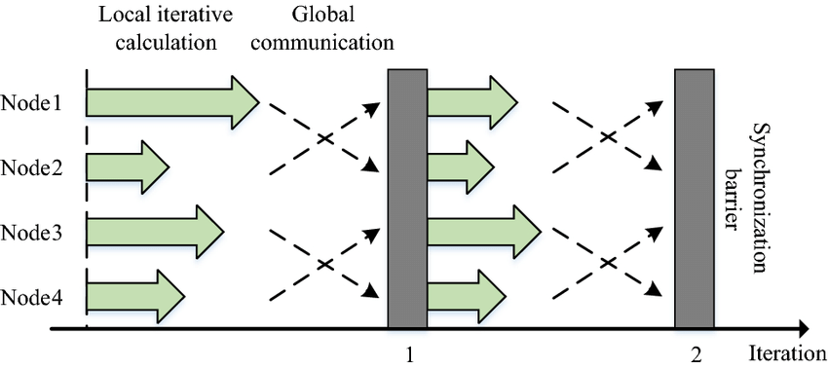
Why synchronization for lab 1?
Anyone can solve embarrassingly parallel problems; the difficult part is coordinating between tasks, a.k.a. synchronization!

Slide 22
Lab 1 Tasks
Connect to lab machines, download code
ex1: processes with fork/wait
ex2: pthreads ordering, counter variable
Bonus: Semaphore usage
ex3: race condition
ex4: pthread joining
ex5: pthread mutexes
ex6: condition variables (starts to get challenging)
ex7: producer-consumer: pthreads (for submission)
ex8: producer-consumer: processes and semaphores (for submission)
ex9: explaining ex7 and ex8 (for submission)
Visiting the PDC lab downstairs

Slide 23
Let’s get started!
Ask for help if you can’t SSH!
For advanced users: generate SSH key, copy your key to the pdc machines, set up your SSH config file…
nus-cs3210.github.io/student-guide/accessing
Get SoC ID
Check email for PDC Lab username & password
Get SoC VPN (not for right now, but for accesses outside SoC)
SSH to soctf-pdc-xxx.d1.comp.nus.edu.sg
xxx is 001-003 or 009-011; don’t crowd 001 :’)
Download lab code into the machines and start the lab :D
wget https://www.comp.nus.edu.sg/~srirams/cs3210/L1_code.zip
unzip L1_code.zip
For VSCode users, SSH into the node with bash/powershell first to change your password before using VSCode to connect!

Slide 24
[Extra] Quality-of-life for SSH
Consider adding the following to ~/.ssh/config
Host pdc-003
HostName soctf-pdc-003.d1.comp.nus.edu.sg
User [insert your lab id here]
ForwardAgent yes
Now you can just type ssh pdc-003 to connect :)
Generate your SSH key: ssh-keygen -t ed25519
Add your public key (.pub) to pdc.comp.nus.edu.sg/accounts/profile/
Modify your config:
Host pdc-003
HostName soctf-pdc-003.d1.comp.nus.edu.sg
User [insert your lab id here]
ForwardAgent yes
IdentityFile ~/.ssh/id_ed25519

Slide 25
Named vs. Unnamed Semaphores
Named semaphores (created with sem_open) are "automatically shared between processes" - how?
Processes duplicate their memory spaces on fork()
Parent process executes:
sem_t* sem = sem_open("pSem", O_CREAT | O_EXCL, 0644, value);
So, shouldn't the semaphore be private to each process?

Slide 26
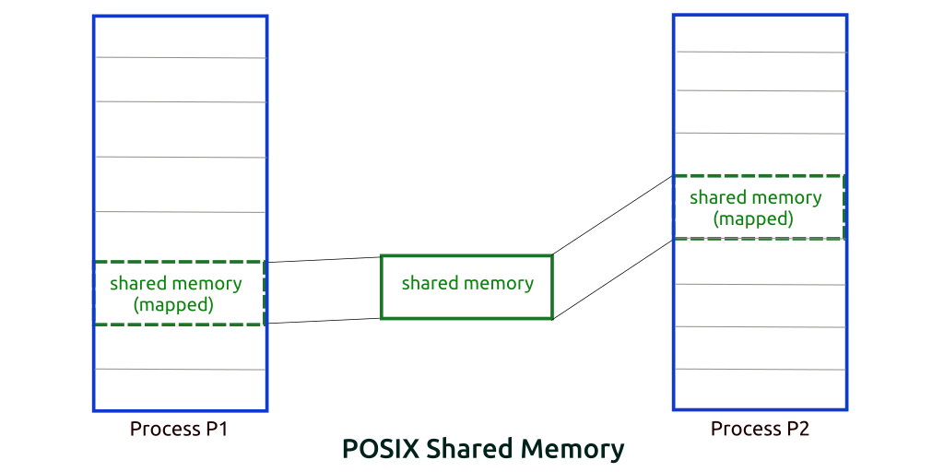
Named vs. Unnamed Semaphores
Shouldn’t the semaphore be private to each process?
OS auto-maps semaphore into shared memory for us!
It even saves it as a virtual file
Try:
./semaph
Ctrl+Z after entering sem value
ipcs; ls /dev/shm
fg; Ctrl+C; ipcs; ls /dev/shm;
ipcrm -M ..
pSem

Slide 27
Shared Memory Usage
You may have allocated things in shared memory within your process and terminated it prematurely before cleanup.
To resolve:
ipcs –cm | Check shm usage on machine
ipcrm –M <key> | Delete the memory area
ls –la /dev/shm | Check for named semaphores
rm /dev/shm/<sem> | Remove named semaphores

Slide 28
Binary Semaphores vs. pthread Mutexes
What is the difference?

Slide 29
Binary Semaphores vs. pthread Mutexes
What is the difference?
Hint: who can unlock mutexes?

Slide 30
Condition Variables: Why?
Semaphores can be too generic to map nicely to all problems
Increment / Decrement integer
Mutex: suffers from similar issues

Slide 31
Condition Variables: Why?
Can you spot anything wrong with this code?
Waiting thread
while(true) {
pthread_mutex_lock(&mutex);
if (condition is satisfied) {
// Do something when cond satisfied
done = true;
}
pthread_mutex_unlock(&mutex);
if (done) break;
}
Signalling thread
pthread_mutex_lock(&mutex);
/* change variable value to make condition satisfied */
pthread_mutex_unlock(&mutex);

Slide 32
Condition Variables: Why?
Let’s shuffle things a little bit to make it better
Waiting thread
pthread_mutex_lock(&mutex);
if (condition not satisfied) {
pthread_mutex_unlock(&mutex);
while (condition not satisfied) { //wait }
pthread_mutex_lock(&mutex);
}
// Do something, condition satisfied
pthread_mutex_unlock(&mutex);
Signalling thread
pthread_mutex_lock(&mutex);
/* change variable value to make condition satisfied */
pthread_mutex_unlock(&mutex);

Slide 33
Condition Variables: Why?
What happens if there are two waiting threads?
Waiting thread 1
1 pthread_mutex_lock(&mutex);
2 if (condition not satisfied) {
3 pthread_mutex_unlock(&mutex);
4 while (condition not satisfied) { //wait }
5 pthread_mutex_lock(&mutex);
6 }
7 // Do something, condition satisfied
8
9 pthread_mutex_unlock(&mutex);
Waiting thread 2
1 pthread_mutex_lock(&mutex);
2 if (condition not satisfied) {
3 pthread_mutex_unlock(&mutex);
4 while (condition not satisfied) { //wait }
5 pthread_mutex_lock(&mutex);
6 }
7 // Do something, condition satisfied
8
9 pthread_mutex_unlock(&mutex);
1. Both waiting threads are waiting
Signalling thread
pthread_mutex_lock(&mutex);
/* change variable value to satisfy cond */
pthread_mutex_unlock(&mutex);

Slide 34
Condition Variables: Why?
What happens if there are two waiting threads?
Waiting thread 1
1 pthread_mutex_lock(&mutex);
2 if (condition not satisfied) {
3 pthread_mutex_unlock(&mutex);
4 while (condition not satisfied) { //wait }
5 pthread_mutex_lock(&mutex);
6 }
7 // Do something, condition satisfied
8
9 pthread_mutex_unlock(&mutex);
Waiting thread 2
1 pthread_mutex_lock(&mutex);
2 if (condition not satisfied) {
3 pthread_mutex_unlock(&mutex);
4 while (condition not satisfied) { //wait }
5 pthread_mutex_lock(&mutex);
6 }
7 // Do something, condition satisfied
8
9 pthread_mutex_unlock(&mutex);
2. Signalling thread changes the variable value
Signalling thread
pthread_mutex_lock(&mutex);
/* change variable value to satisfy cond */
pthread_mutex_unlock(&mutex);

Slide 35
Condition Variables: Why?
What happens if there are two waiting threads?
Waiting thread 1
1 pthread_mutex_lock(&mutex);
2 if (condition not satisfied) {
3 pthread_mutex_unlock(&mutex);
4 while (condition not satisfied) { //wait }
5 pthread_mutex_lock(&mutex);
6 }
7 // Do something, condition satisfied
8
9 pthread_mutex_unlock(&mutex);
Waiting thread 2
1 pthread_mutex_lock(&mutex);
2 if (condition not satisfied) {
3 pthread_mutex_unlock(&mutex);
4 while (condition not satisfied) { //wait }
5 pthread_mutex_lock(&mutex);
6 }
7 // Do something, condition satisfied
8
9 pthread_mutex_unlock(&mutex);
3. Both waiting threads exit the busy wait; T1 gets the mutex
Signalling thread
pthread_mutex_lock(&mutex);
/* change variable value to satisfy cond */
pthread_mutex_unlock(&mutex);

Slide 36
Condition Variables: Why?
What happens if there are two waiting threads?
Waiting thread 1
1 pthread_mutex_lock(&mutex);
2 if (condition not satisfied) {
3 pthread_mutex_unlock(&mutex);
4 while (condition not satisfied) { //wait }
5 pthread_mutex_lock(&mutex);
6 }
7 // Do something, condition satisfied
8
9 pthread_mutex_unlock(&mutex);
Waiting thread 2
1 pthread_mutex_lock(&mutex);
2 if (condition not satisfied) {
3 pthread_mutex_unlock(&mutex);
4 while (condition not satisfied) { //wait }
5 pthread_mutex_lock(&mutex);
6 }
7 // Do something, condition satisfied
8
9 pthread_mutex_unlock(&mutex);
4. T1 does something that invalidates the condition
Signalling thread
pthread_mutex_lock(&mutex);
/* change variable value to satisfy cond */
pthread_mutex_unlock(&mutex);

Slide 37
Condition Variables: Why?
What happens if there are two waiting threads?
Waiting thread 1
1 pthread_mutex_lock(&mutex);
2 if (condition not satisfied) {
3 pthread_mutex_unlock(&mutex);
4 while (condition not satisfied) { //wait }
5 pthread_mutex_lock(&mutex);
6 }
7 // Do something, condition satisfied
8
9 pthread_mutex_unlock(&mutex);
Waiting thread 2
1 pthread_mutex_lock(&mutex);
2 if (condition not satisfied) {
3 pthread_mutex_unlock(&mutex);
4 while (condition not satisfied) { //wait }
5 pthread_mutex_lock(&mutex);
6 }
7 // Do something, condition satisfied
8
9 pthread_mutex_unlock(&mutex);
5. T1 releases mutex, T2 gets the mutex
Signalling thread
pthread_mutex_lock(&mutex);
/* change variable value to satisfy cond */
pthread_mutex_unlock(&mutex);

Slide 38
Condition Variables: Why?
What happens if there are two waiting threads?
Waiting thread 1
1 pthread_mutex_lock(&mutex);
2 if (condition not satisfied) {
3 pthread_mutex_unlock(&mutex);
4 while (condition not satisfied) { //wait }
5 pthread_mutex_lock(&mutex);
6 }
7 // Do something, condition satisfied
8
9 pthread_mutex_unlock(&mutex);
Waiting thread 2
1 pthread_mutex_lock(&mutex);
2 if (condition not satisfied) {
3 pthread_mutex_unlock(&mutex);
4 while (condition not satisfied) { //wait }
5 pthread_mutex_lock(&mutex);
6 }
7 // Do something, condition satisfied
8
9 pthread_mutex_unlock(&mutex);
6. T2 gets to the critical section but condition might no longer be satisfied!
Signalling thread
pthread_mutex_lock(&mutex);
/* change variable value to satisfy cond */
pthread_mutex_unlock(&mutex);

Slide 39
Condition Variables: Why?
Fixing the ‘sniping’ behaviour
Waiting thread 1
1 pthread_mutex_lock(&mutex);
2 while (condition not satisfied) {
3 pthread_mutex_unlock(&mutex);
4 while (condition not satisfied) { //wait }
5 pthread_mutex_lock(&mutex);
6 }
7 // Do something, condition satisfied
8
9 pthread_mutex_unlock(&mutex);
Waiting thread 2
1 pthread_mutex_lock(&mutex);
2 while (condition not satisfied) {
3 pthread_mutex_unlock(&mutex);
4 while (condition not satisfied) { //wait }
5 pthread_mutex_lock(&mutex);
6 }
7 // Do something, condition satisfied
8
9 pthread_mutex_unlock(&mutex);
Signalling thread
pthread_mutex_lock(&mutex);
/* change variable value to satisfy cond */
pthread_mutex_unlock(&mutex);

Slide 40
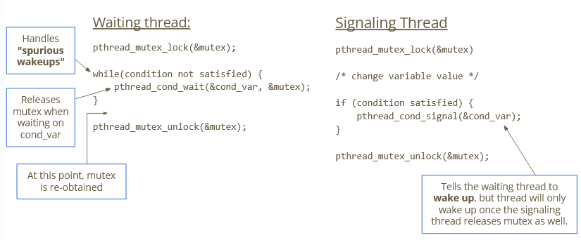
Condition Variables

Slide 41
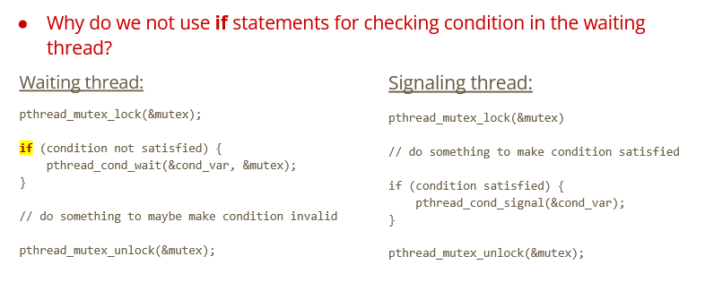
Condition Variables: Spurious Wakeups

Slide 42
Condition Variables: Spurious Wakeups
Spurious wakeup: occurs when a thread wakes up from waiting and finds that the condition is still unsatisfied. (Credit: Wikipedia)
It can happen due to (but is not limited to):
Implementation
the thread blocked suddenly wakes up even though no signal or broadcast occurs
Race conditions
what happens if two threads wake up at the same time?

Slide 43
Summary
Connecting to lab machines
Processes and threads
Mutexes / Semaphores / Condition Variables

Slide 44
End of Lab 1
Telegram group: scan on right
Slides will be uploaded after every session
Feedback: bit.ly/feedback-theodore
Email: theo@comp.nus.edu.sg
Now: PDC Lab Visit (and back again)

